Slide 1
Understanding User Music Preferences using Spotify Data
Capstone Project
Jeremy Osir
NYCDSA
Winter 2022 Cohort

Slide 2
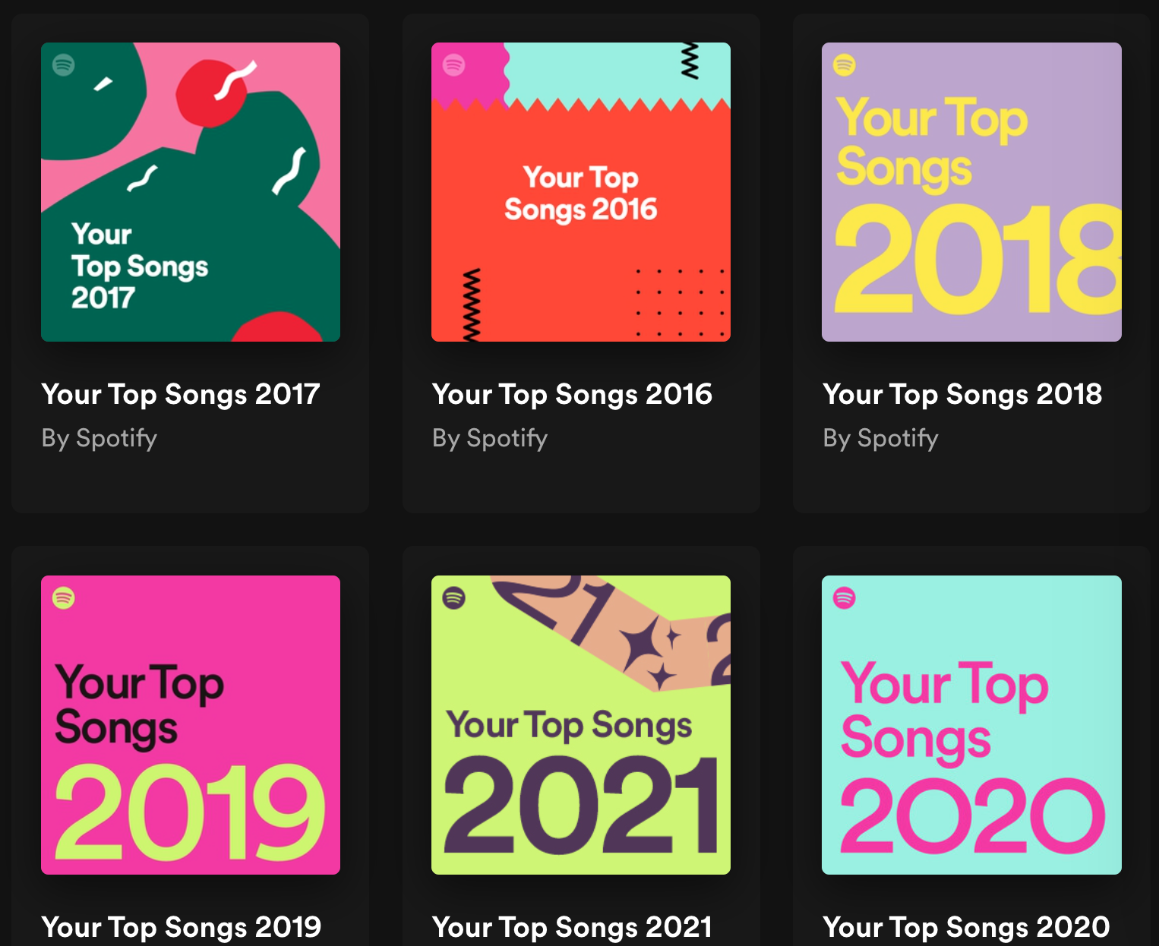
Agenda
Project overview
Visualizing my favorite songs
Modelling my music ‘taste profile’
Summary and next steps

Slide 3
Project Overview
Objective: Build a machine learning model that develops my ‘taste profile’ based on my favorite Spotify tracks and can predict whether a new song suits my taste.
Using Spotify’s API, scraped the following data:
500 of my favorite songs, 2017 - 2020:
Used to investigate my musical taste
500 songs
50 of the Top Songs in the USA
This will be compared with my top tracks to see how my music taste compares to popular tracks of the day
50 songs

Slide 4

Overview of song attributes
In addition to basic track information, Spotify also provides several audio attributes:
Beats Per Minute (BPM) — The tempo of the song.
Energy — The higher the value, the more energetic.
Danceability — The higher the value, the more danceable the track
Loudness — The higher the value, the louder the song (in dB).
Valence — The higher the value, the more positive the mood.
Length — The duration of the song.
Acousticness — The higher the value the more acoustic the song
Instrumentalness — the higher the value, the fewer the vocals
Liveness — higher value indicate the presence of a live audience
Mode — indicates the modality (major or minor) of a track
Notes:
Mood:
Context:

Slide 5
Comparing my Favorite Tracks to the Top 50 Songs in the USA

Slide 6
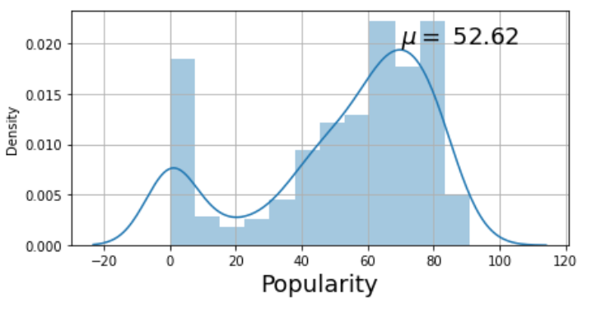
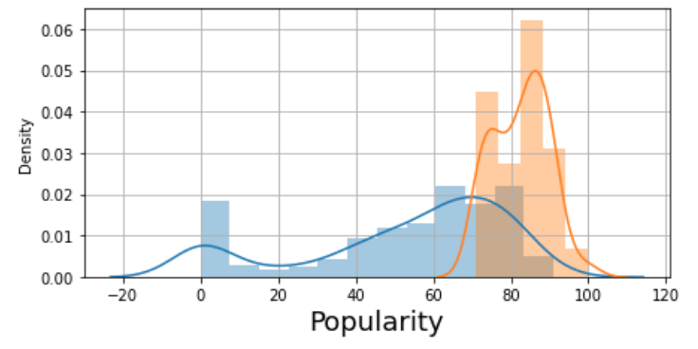
Top USA hits tend to be more popular than my favorite songs
My favorite songs
My favorite songs vs Top USA hits

Slide 7
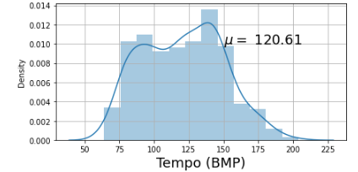
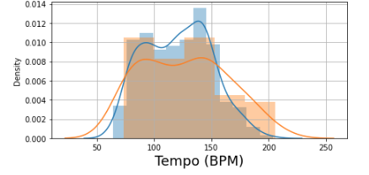
My favorite tracks tend to have a higher tempo
My favorite songs
My favorite songs vs Top USA hits
My top tracks have a larger peak at higher BPMs, due to techno songs
Techno BPM tends to be 120-160
Hip-Hop BPM tends to be 85-115

Slide 8
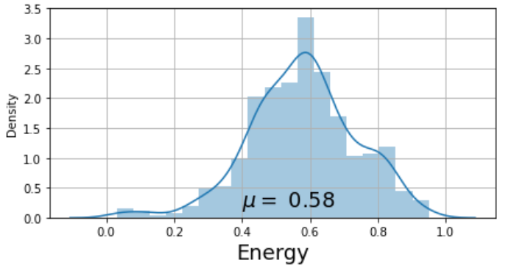
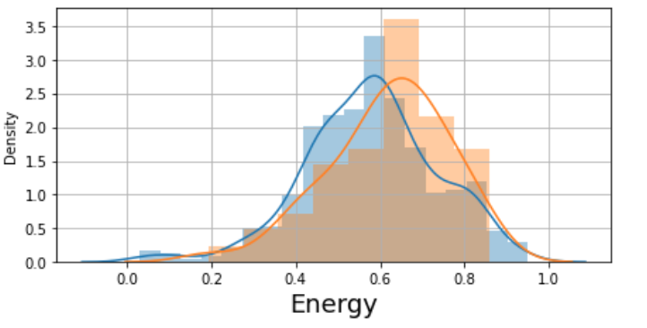
Energy levels for Top USA Tracks are slightly higher
My favorite songs
My favorite songs vs Top USA hits

Slide 9
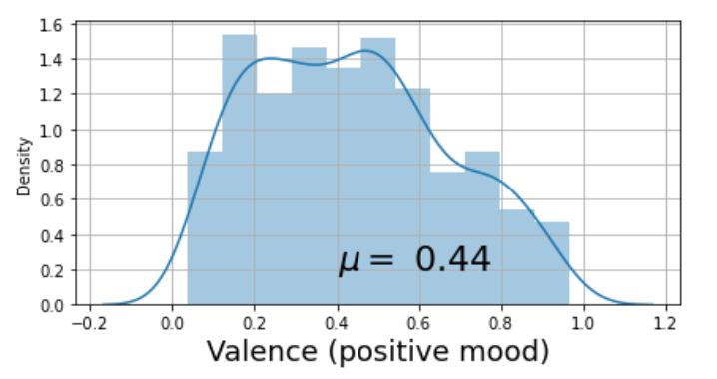
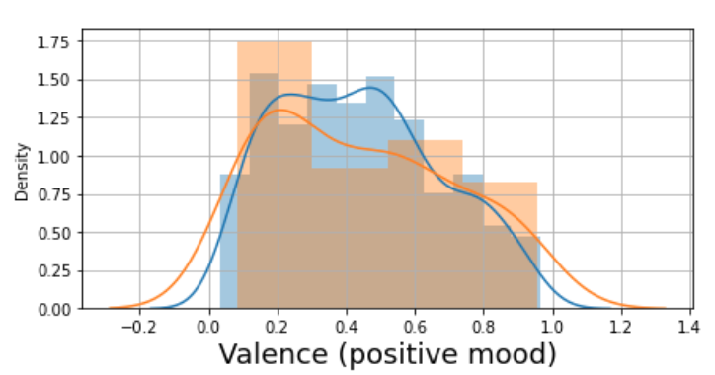
My favorite tracks tended to be more positive than the Top Hits
My favorite songs
My favorite songs vs Top USA hits

Slide 10
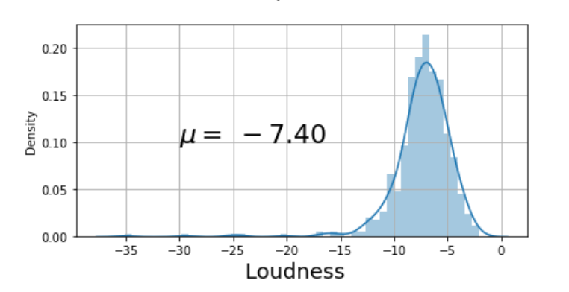
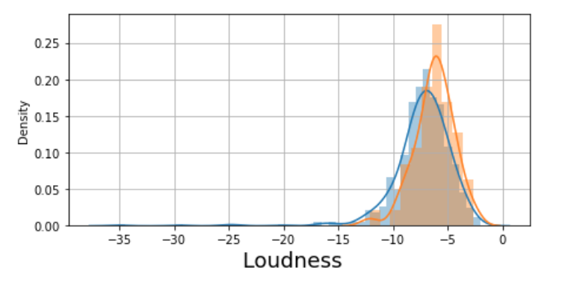
My favorite tracks tended to be louder than Top USA charts
My favorite songs
My favorite songs vs Top USA hits

Slide 11
Model Evaluation:
One-Class Support Vector Machines

Slide 12
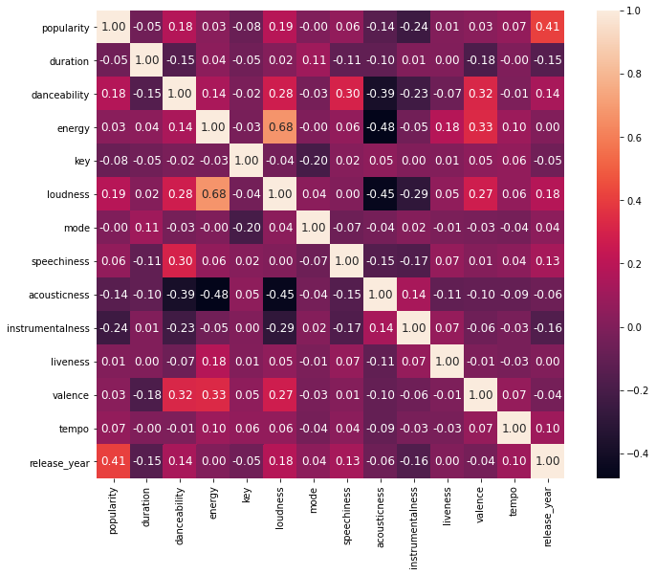
Very little correlation across features, with a few exceptions
Notes:
Features with correlation:
[Energy vs Loudness]: 0.68
[Loudness vs Acousticness]: -0.4
[Energy vs Acousticness]: -0.46

Slide 13
Principal Component Analysis to reduce feature dimensionality
My ‘favorite tracks’ dataset contains 500 observations, each with 10 numerical features. For my purposes I decided to focus on features that described the musical attributes of the tracks:
['danceability', 'energy', 'loudness', 'mode', 'speechiness', 'acousticness', 'instrumentalness', 'liveness', 'valence', 'tempo']
PCA is an unsupervised machine learning technique that can reduce the number of dimensions - thus enabling us to project high dimensional data to a low-dimensional plane e.g. 2-D.
Ran PCA after normalizing the attributes with scikit-learn’s StandardScaler

Slide 14
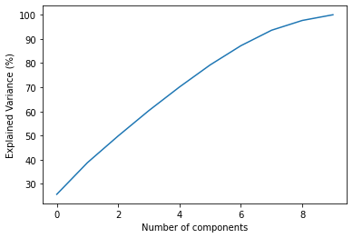
PCA Output
Component | Top 3 Features in Component | Variance explained (cumulative)
First | ['loudness', 'energy', 'acousticness'] | 25.7%
Second | ['speechiness', 'danceability', 'instrumentalness'] | 38.8%
Third | ['mode', 'tempo', 'valence'] | 49.8%
Ten (all features) | ['energy', 'loudness', 'danceability'] | 100%

Slide 15
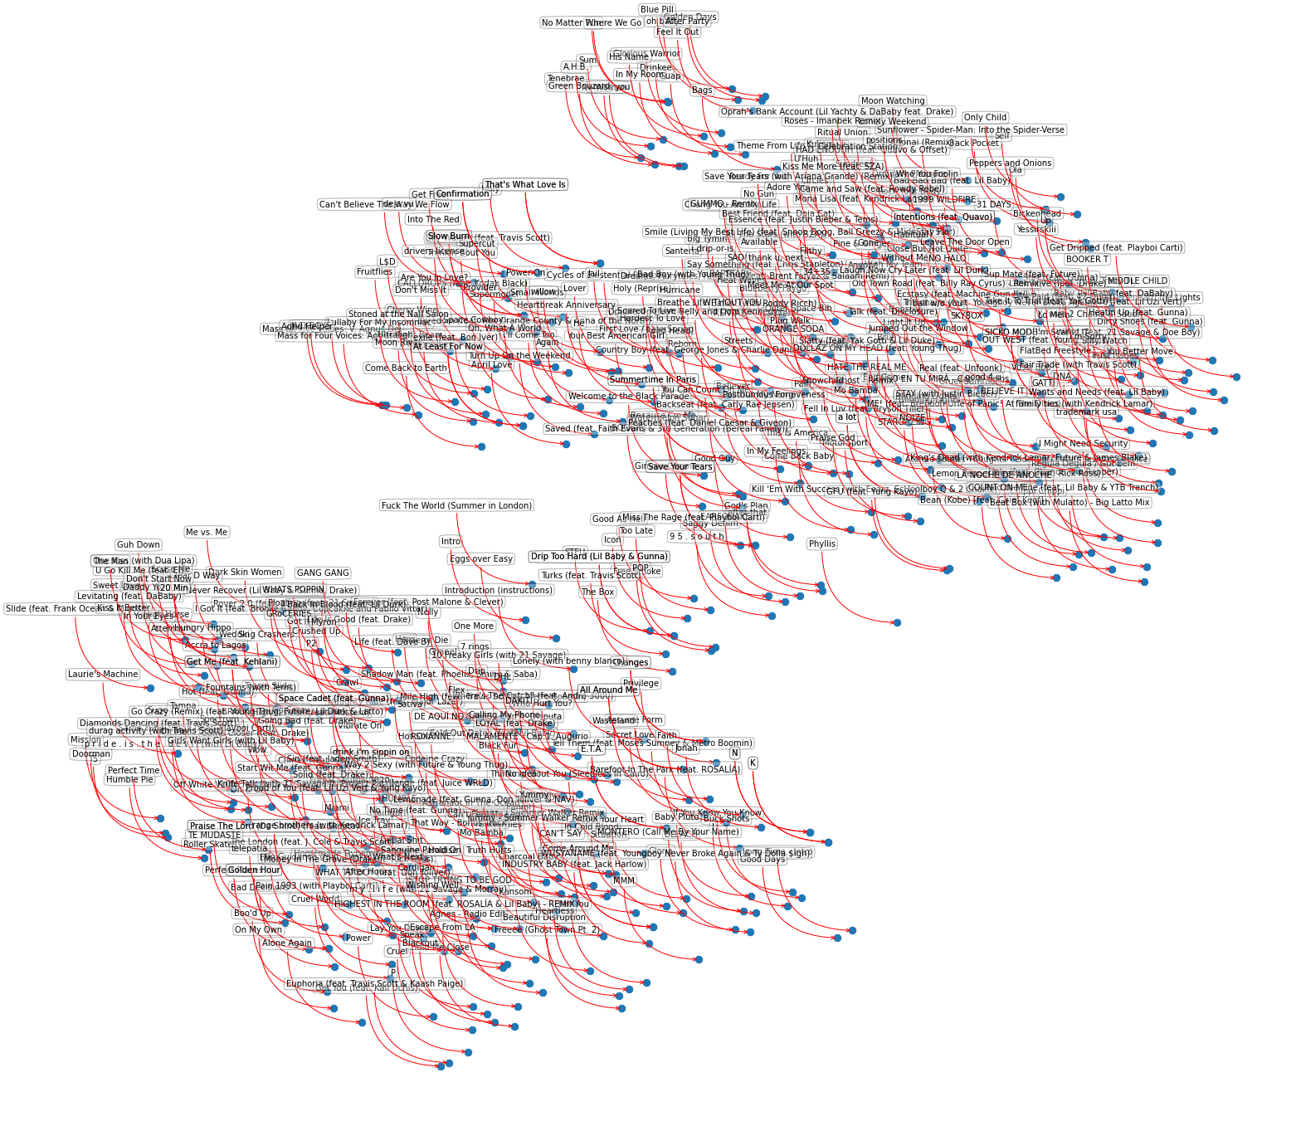
Visualizing my favorite tracks in 2-D space

Slide 16
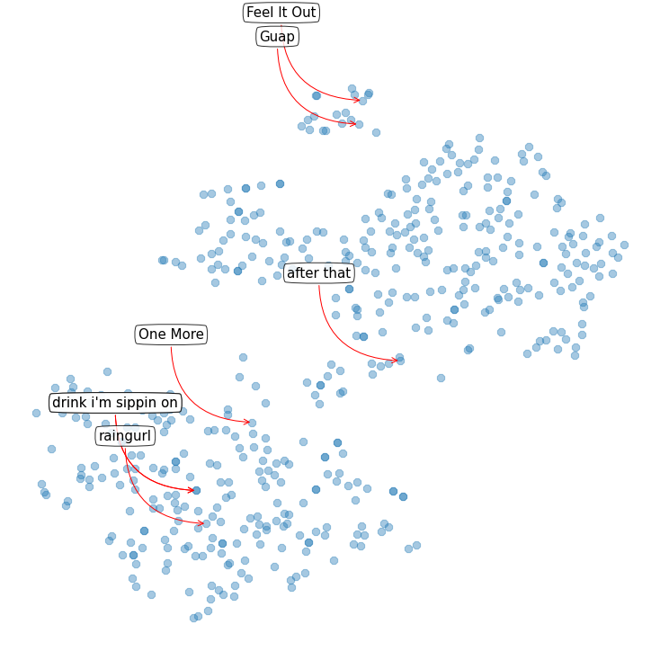
Spotlight on a specific artist ‘Yaeji’
Techno songs, fewer vocals
These songs are more ‘pop’, with vocals

Slide 17
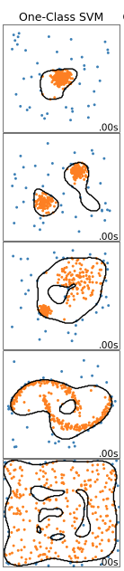
One-Class Support Vector Machine
The problem of building my ‘taste profile’ was modeled as a classification problem.
One challenge, unlike classification problems that have multiple classes — my ‘Favorite Songs’ dataset only included one-class i.e. songs that I like.
One-class SVM is an algorithm that can learn the the decision boundary of the training data, and predict whether a new observation is similar to the ‘in-class’ observations i.e. ‘songs I like’.
After fitting the OneClassSVM model on our scaled data, and tuning the parameters, we can visualize the ‘taste profile’ learned by the model.

Slide 18
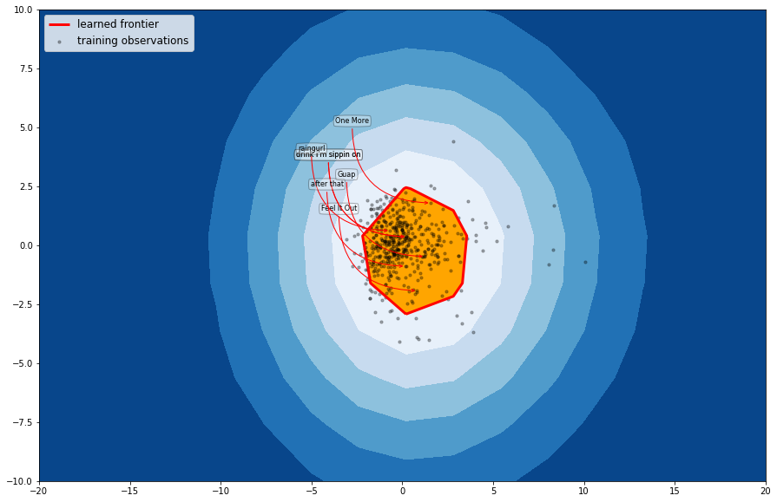
Personalized view of my music taste using OneClassSVM

Slide 19
Summary and Next Steps
Using unsupervised machine learning, we were able to build a ‘taste profile’ based on Spotify listening data.
This can be used to suggest new songs to a user, based on their similarity to my favorite tracks (content-based recommendations)
The taste profile was not perfect – it is difficult to deal with variation in songs.
Some next steps:
Leverage other machine learning models to learn music taste e.g. Neural Nets
Build a web app that allows users to visualize their personal music taste

